Slide 1
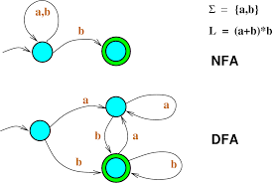
Non Deterministic Finite Automation with €-moves
---- Sakshi Surve

Slide 2
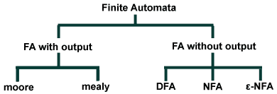

Slide 3
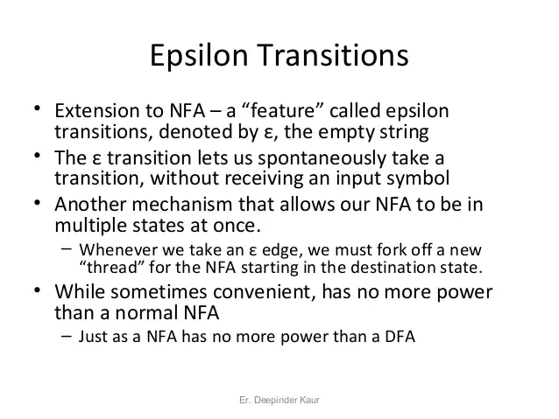

Slide 4
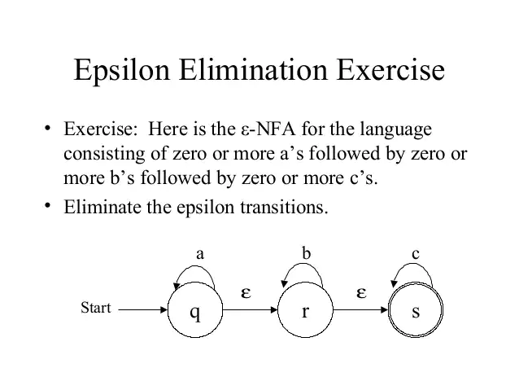

Slide 5
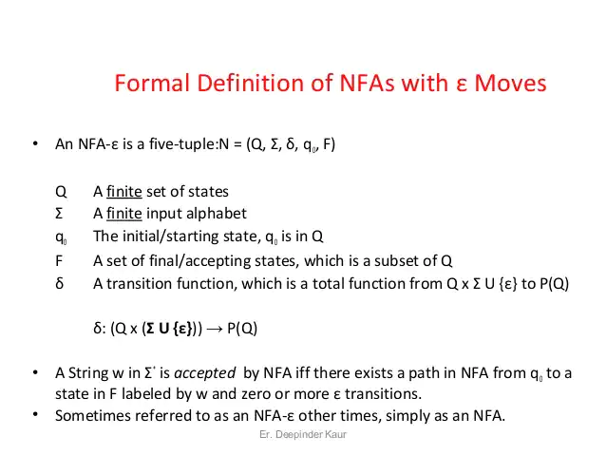

Slide 6
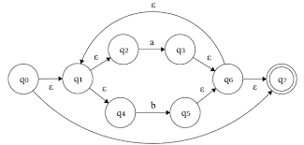

Slide 7
Basic constructs of any RE :
Union (+)
Concatenation(.)
Kleene Closure (*)
Positive Closure (+)
Thomson’s Rules

Slide 8
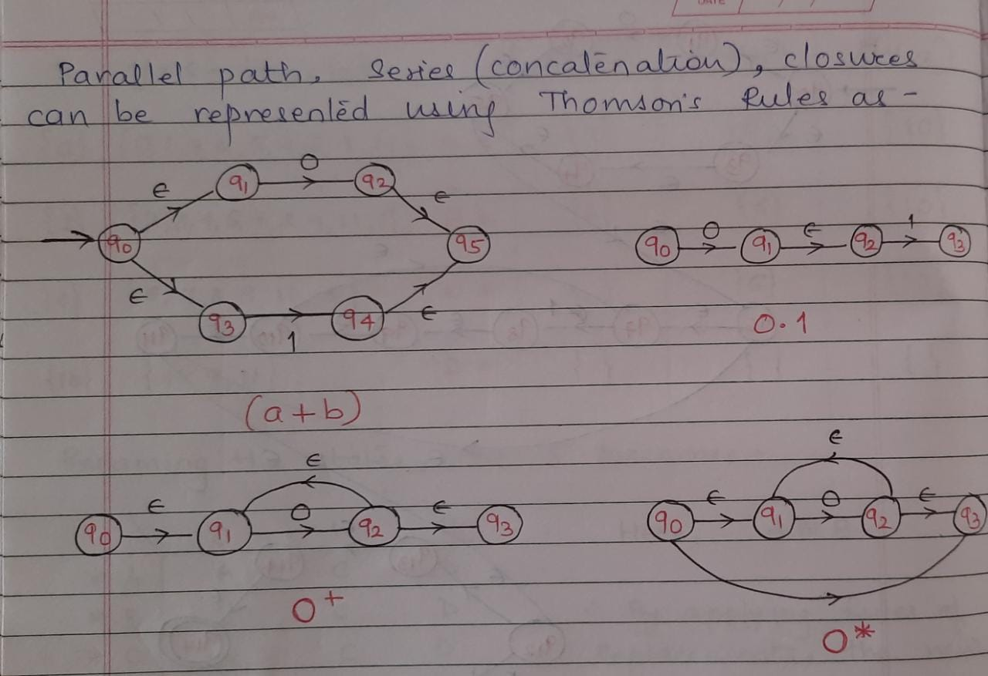
Basic Constructs using Thomson’s Rules :

Slide 9
Design NFA with € -moves for
(a+b)*
(a* + b*)
0* 1* 2*
(0+ €) (10)* (€+1)

Slide 10
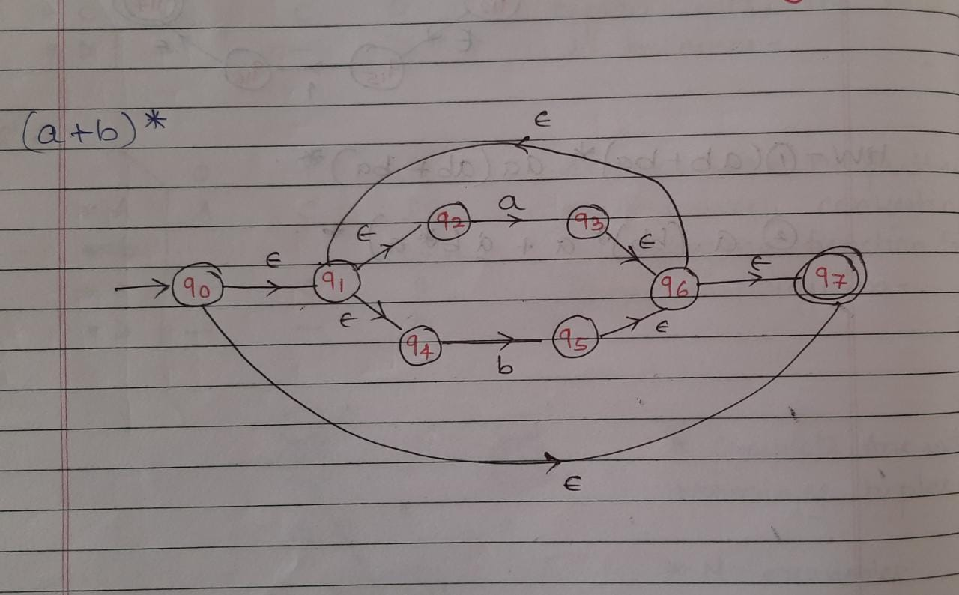

Slide 11
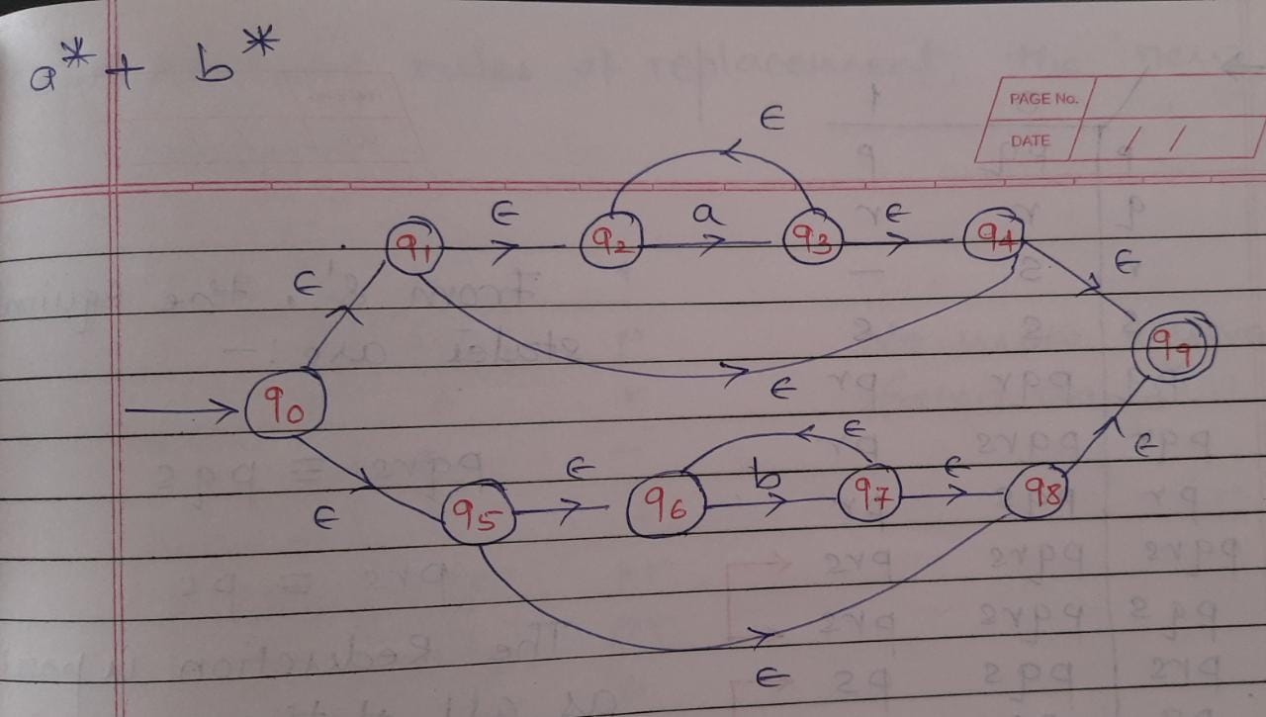

Slide 12
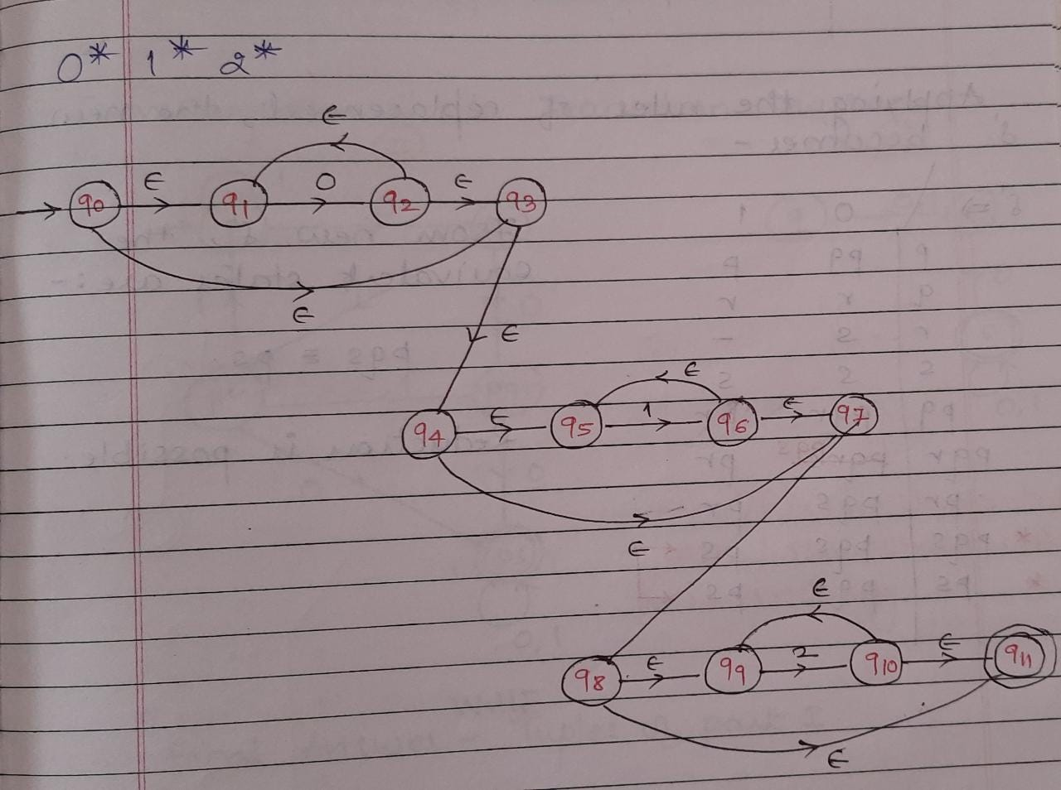

Slide 13
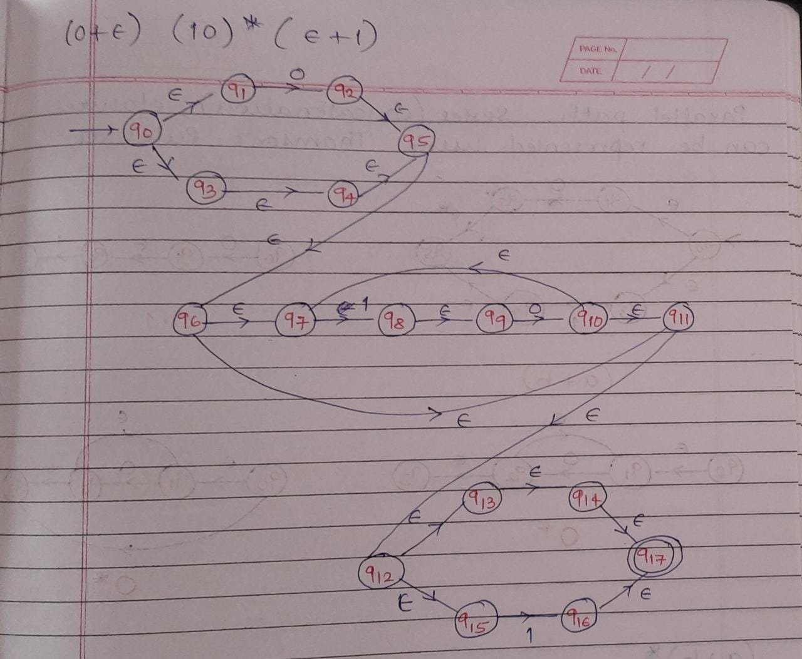

Slide 14
Homework :
Design NFA with € -moves for
(ab +ba)* aa (ab + ba)*
(a(bb)* a + a b* a) *

Slide 15
RE to NFA
NFA with € moves
NFA without € moves
RE
DFA

Slide 16
Design DFA for the following REs
0* 1* 2*
(0+ €) (10)* (€+1)

Slide 17
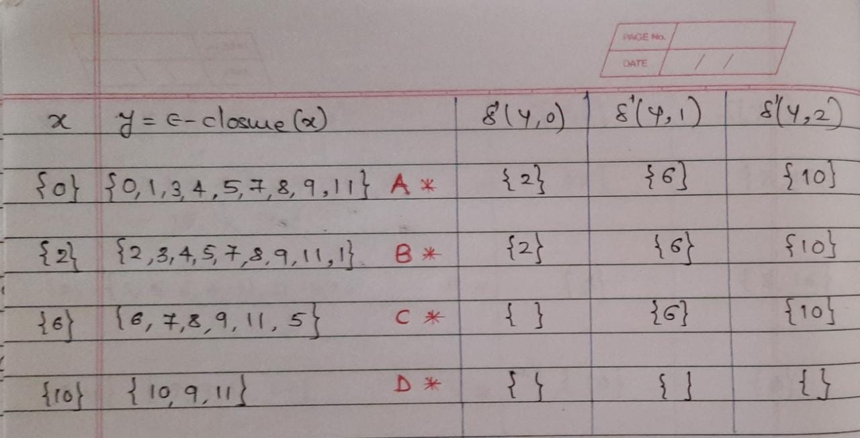
0* 1* 2*

Slide 18
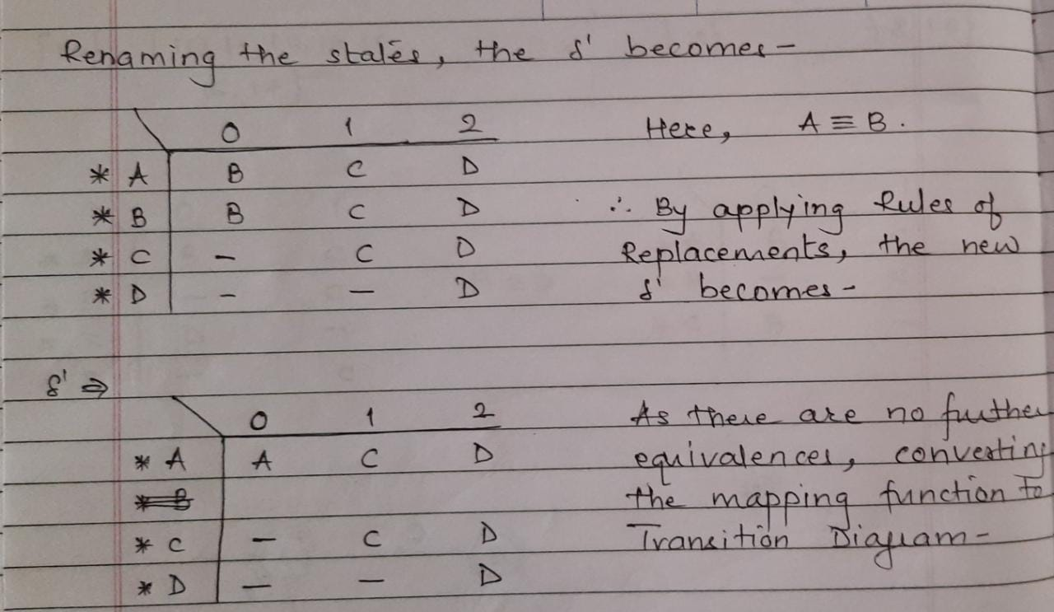

Slide 20
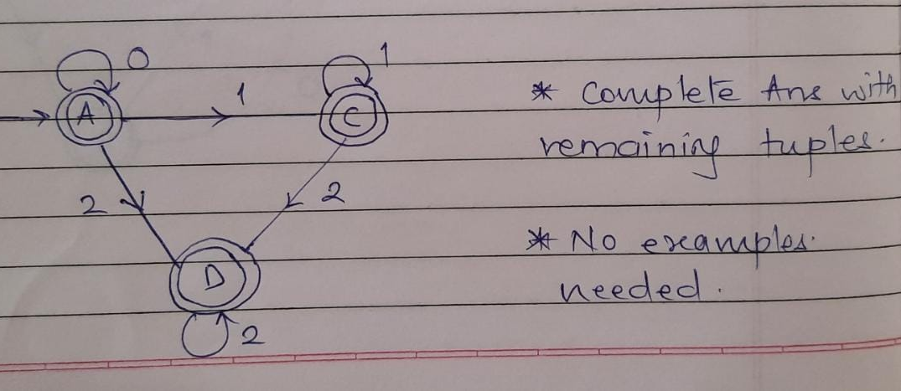

Slide 21
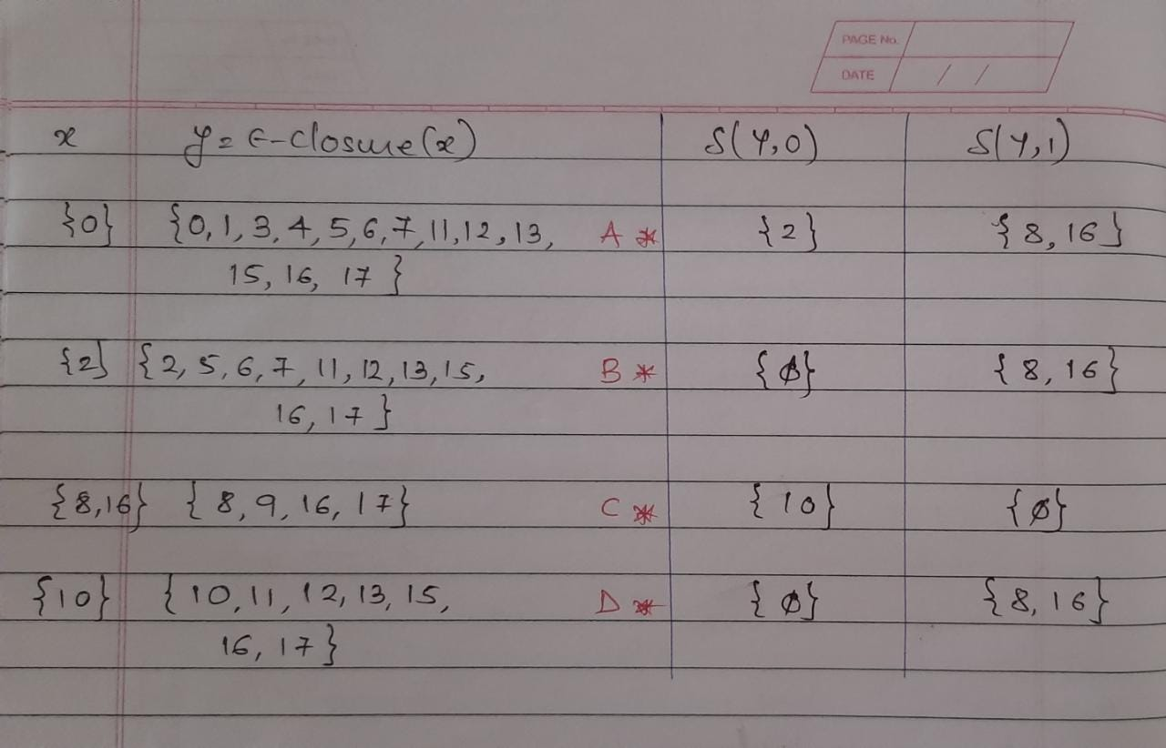
(0+ €) (10)* (€+1)

Slide 22
